Slide 1
Employee Leave Management System
Guided By:-
MR. RUSHIKESH KATAGE
Presented By:-
Anmol Chaudhary
Anubha Singh
Gangasagar Pikle
Utkarsh Garad
Vaibhav Imade

Slide 2
INTRODUCTION
Importance:
Efficient leave management is key to smooth operations.
Current Challenges:
Manual processes are prone to errors and inefficiencies.
Difficult to manage leave schedules in large teams.
Solution:
Implementing an automated Employee Leave Management System.
Benefits:
Accurate leave tracking.
Reduced administrative workload.
Real-time visibility and improved compliance.
Presentation Focus:
Explore features, benefits, and implementation of the system.

Slide 3
OBJECTIVES
Automate the leave request process.
Ensure transparency and accuracy in leave tracking.
Improve communication between HR and employees.
Reduce administrative workload.

Slide 4
SYSTEM FEATURES
Online leave application and approval.
Real-time leave balance tracking.
Customizable leave types (e.g., sick leave, vacation, etc.).
Notification and reminder system.
Integration with payroll and attendance systems.

Slide 5




PLATFORM AND TOOLS
Technologies: J2EE, React, Eclipse.
Web Server: Java server.
Database Server: Mysql server.
Operating System: Windows.

Slide 6
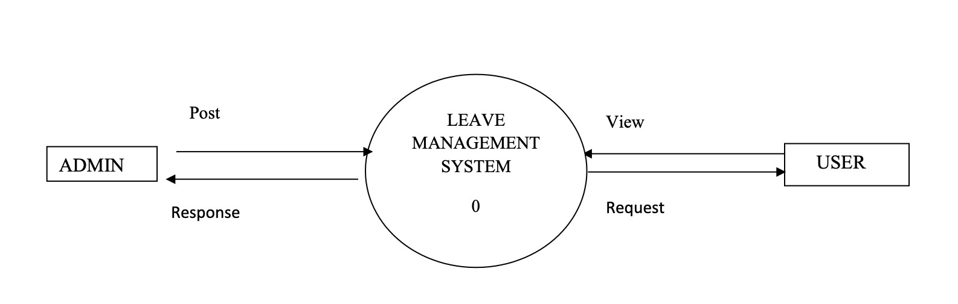
USER ROLES

Slide 7
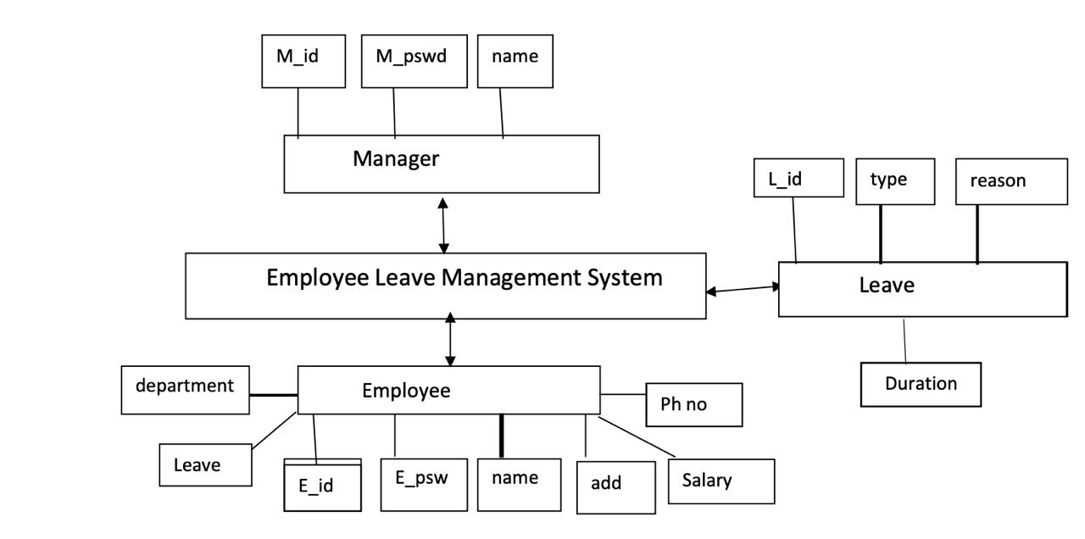
PROCESS

Slide 8

EMPLOYEE MODULE
Login to the portal.
Update Profile.
Submit leave requests.
View leave history and balance.
Receive approval/rejection notifications.

Slide 9
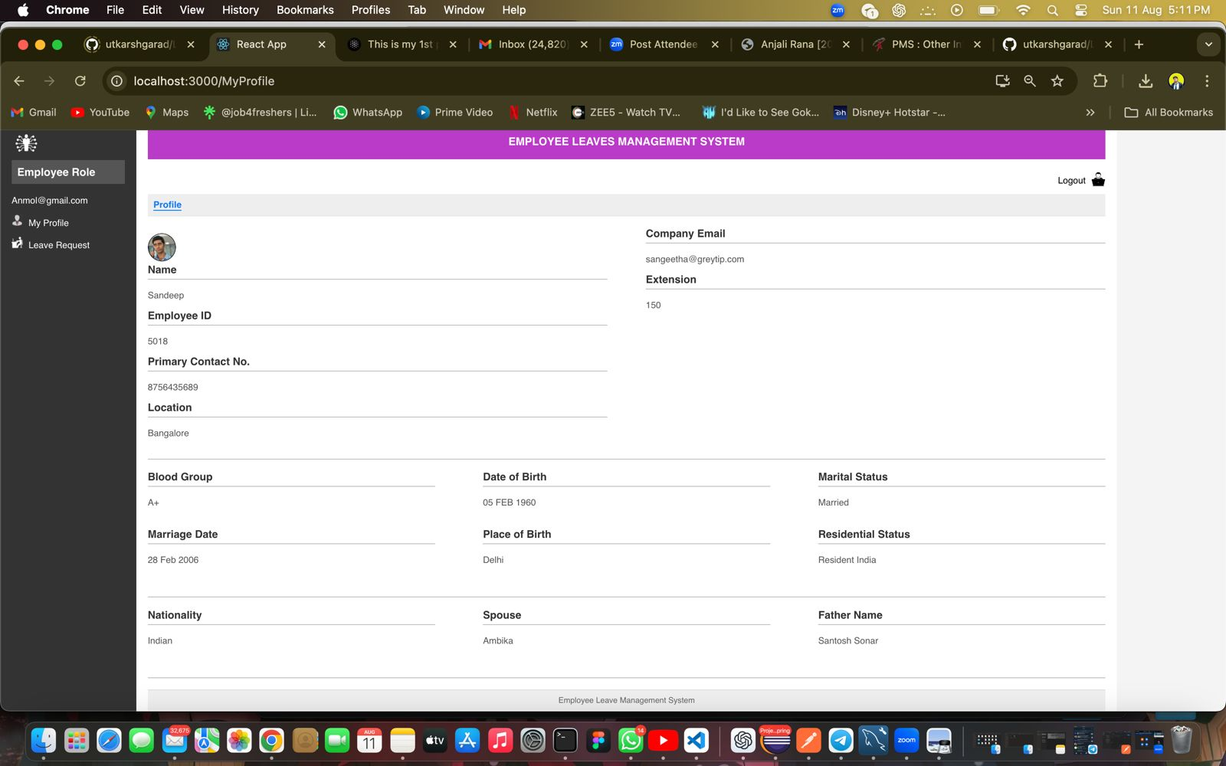
PROTOTYPE

Slide 10
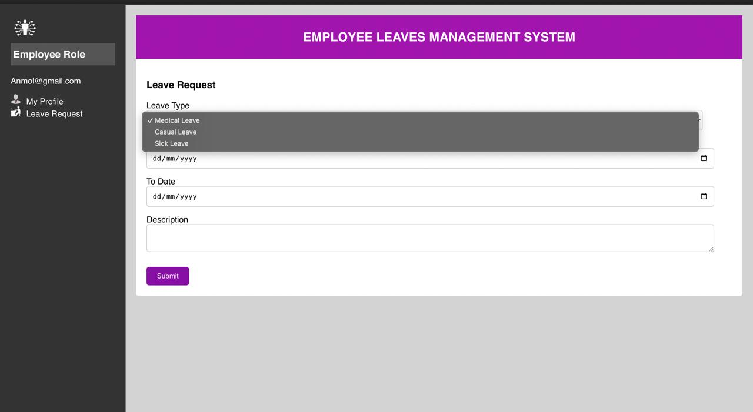

Slide 11
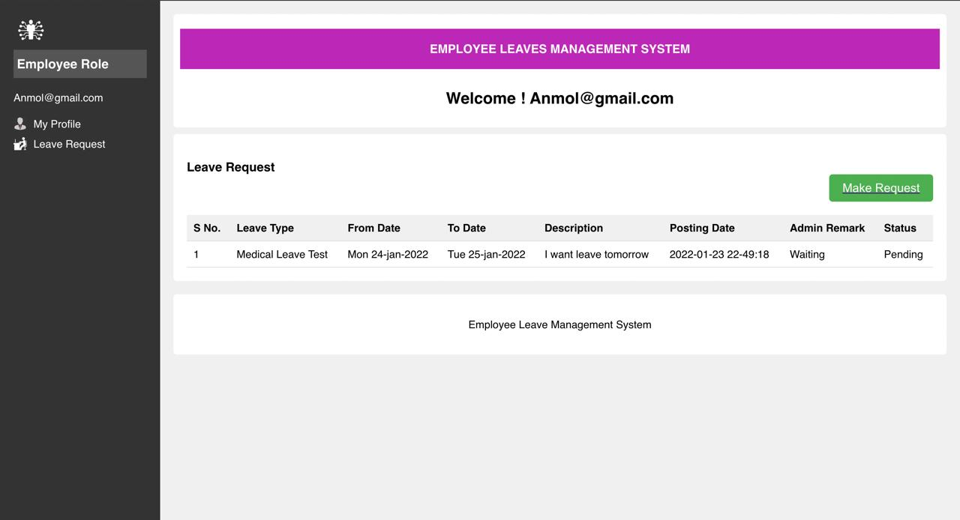

Slide 12
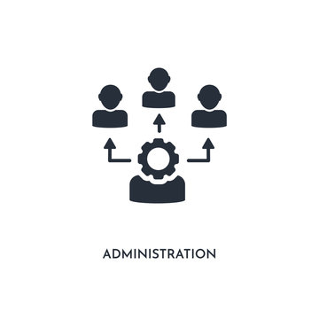
ADMIN MODULE
Review and approve/reject leave requests.
Monitor team leave schedules.
Configure leave policies.
Manage employee data and reports.
Oversee system usage and maintenance.

Slide 13
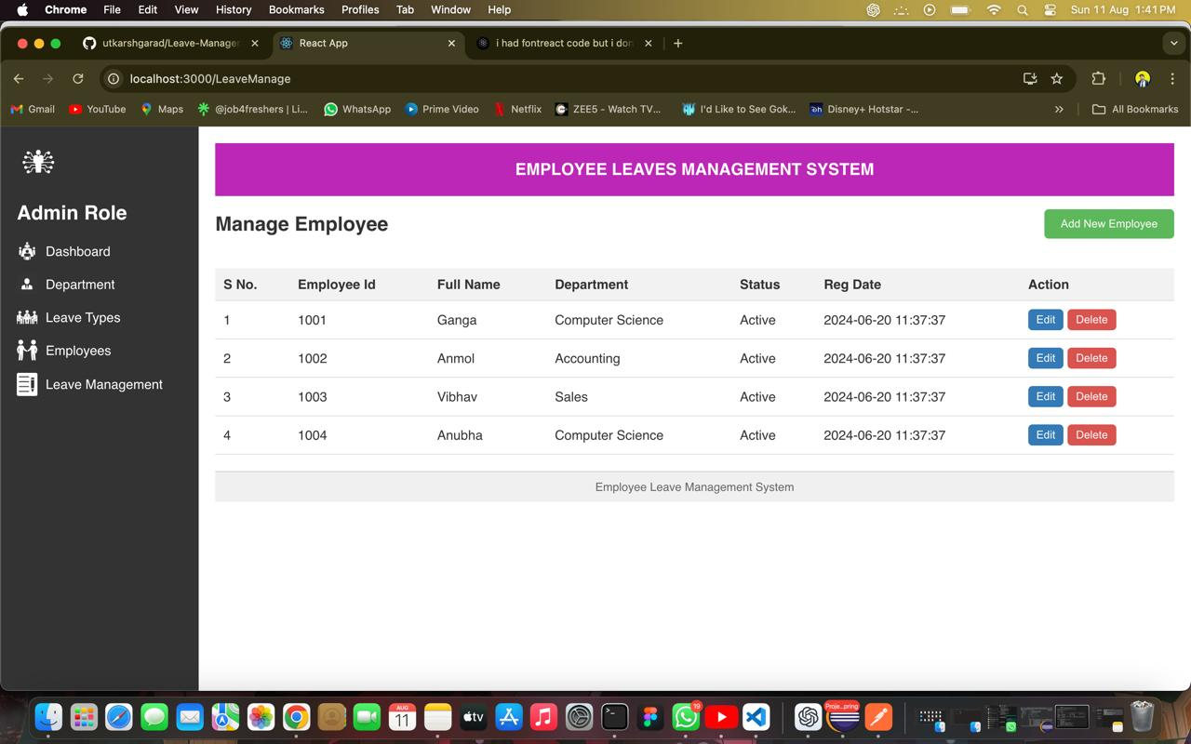
PROTOTYPE

Slide 14
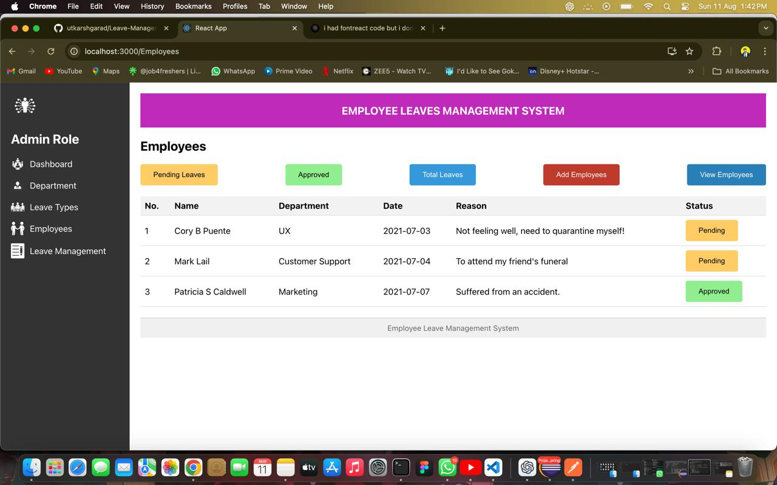

Slide 16
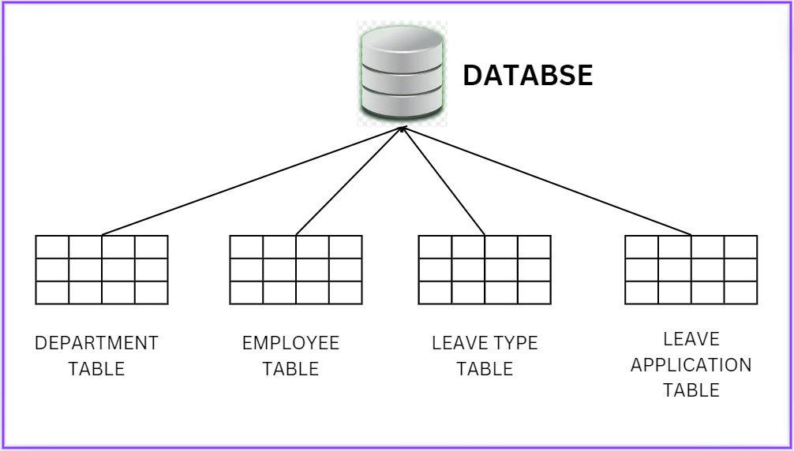
DATABASE

Slide 17
CONCLUSION
Streamlined Process:
Automates leave requests, approvals, and tracking.
Key Benefits:
Improves accuracy, reduces admin tasks, and enhances compliance.
Impact:
Increases efficiency, transparency, and employee satisfaction.
Next Steps:
Consider implementation to optimize leave management.

Slide 18


